Slide 1


An Introduction to Flutter
Don Ward
@donwardpeng

Slide 2

Who am I?
Led Quicken Loans Mobile Team for a few years
Founder and Co-Lead GDG Detroit for 7 years
Founder and Leader of GDG Windsor ~ 1 year

Slide 3


The Agenda
What is Flutter?
What is Dart?
Why?
Let’s code!

Slide 4
What is Flutter?
Open Source Cross Platform Mobile Development
Announced 2015
Flutter 1.0 - Dec 2018
Flutter 1.5 - May 2019
Available on iOS, Android, Web, ChromeOS

Slide 5

What is Dart?
Since 2011
Statically typed language similar to JavaScript and Java
Object-oriented
Syntactic sugar

Slide 6

‘Why?’
Notes:
Why do I like Flutter?
It is very quick to put together an app -> numerous testimonies of coding an app over a weekend
It is intuitive

Slide 7
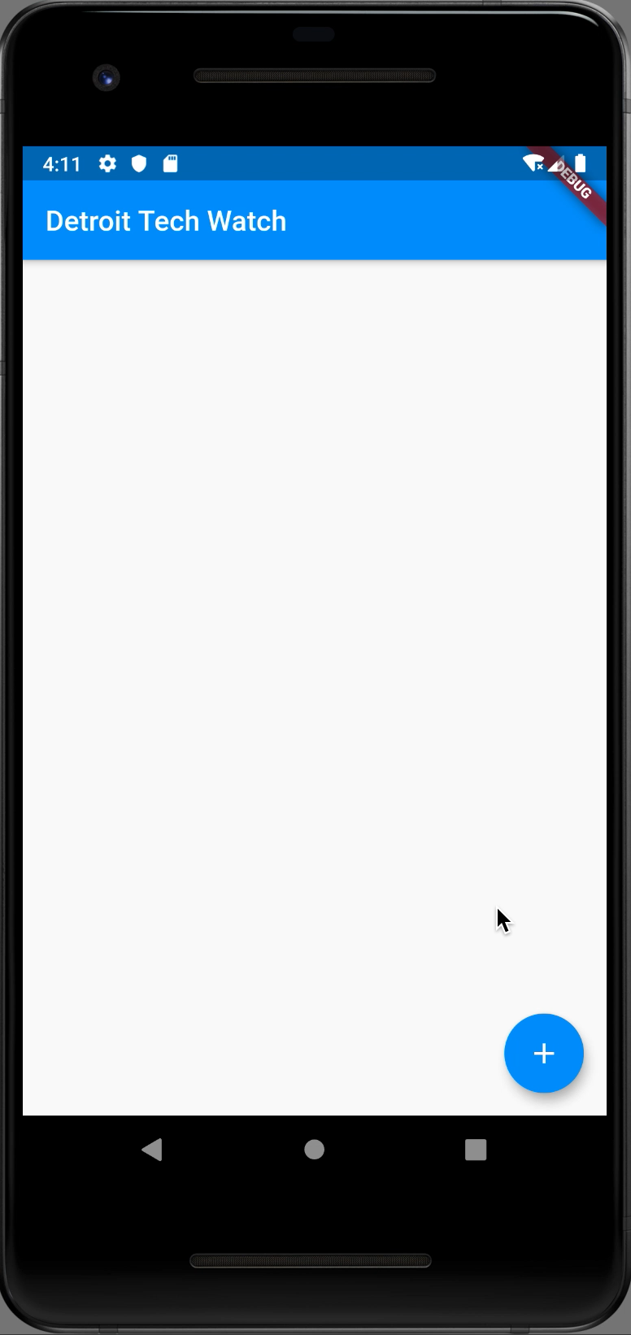

What are we building today?

Slide 8
Let’s start
Flutter SDK installed
Visual Studio Code installed
Android Emulator or iOS Simulator running
https://github.com/donwardpeng/Flutter-DetTechWatch

Slide 9
Let’s talk about the Command Line Tool (CLI)
‘flutter doctor’
‘flutter create <app_name>’
In the <app_name> directory -> ’flutter run’
Hot Reload and Restart
While running, type ‘h’

Slide 10

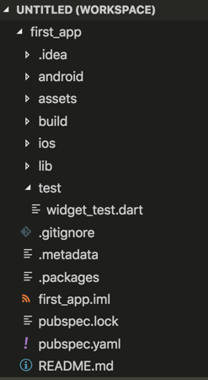
The Project Structure
Notes:
.idea - Android Studio directory
Android - Android build tools
Assets - where you store images, fonts, etc.
Build - where the final build goes
iOS - iOS build tools
Lib - your DART code goes here
Test - any unit tests/automation goes here
Pubspec.yaml -> config for your project

Slide 11
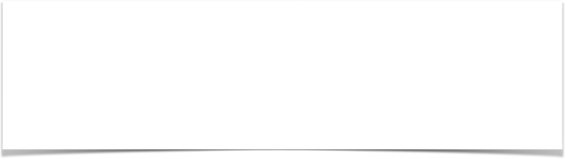
Let’s start from scratch
In VSCode, open the main.dart file
Wipe it clean
Add the code below
//Example 1
import 'package:flutter/material.dart';
void main() {}

Slide 12

Let’s attach something to the screen
The runApp method
In Dart, '=> expr' is equivalent to {return expr};
//Example 2
import 'package:flutter/material.dart';
void main() => runApp(<Widget>);

Slide 13
‘Let’s talk about Widgets’
Notes:
Why do I like Flutter?
It is very quick to put together an app -> numerous testimonies of coding an app over a weekend
It is intuitive

Slide 14
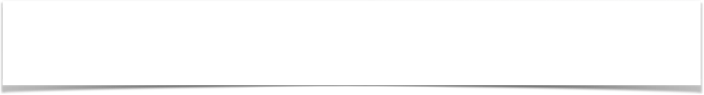
Widgets
Everything is a Widget
Stateless - display only
Stateful - maintains some internal state
class StatelessWidgetExample extends StatelessWidget{};
class StateFullWidgetExample extends StatefulWidget{};

Slide 15
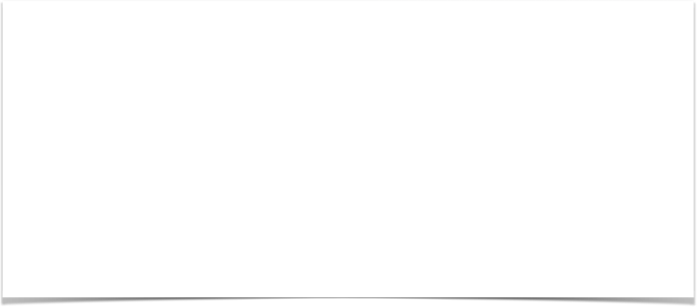
Let’s create our first Widget
//Example 3
import 'package:flutter/material.dart';
void main() => runApp(MyApp());
class MyApp extends StatelessWidget{
@override
Widget build(BuildContext context) {
// TODO: implement build
return null;
}
}
Notes:
All Widgets have a build method
The build method draws on the screen
Stateless widgets need only a build method
Stateful widgets need more (more to come)

Slide 16
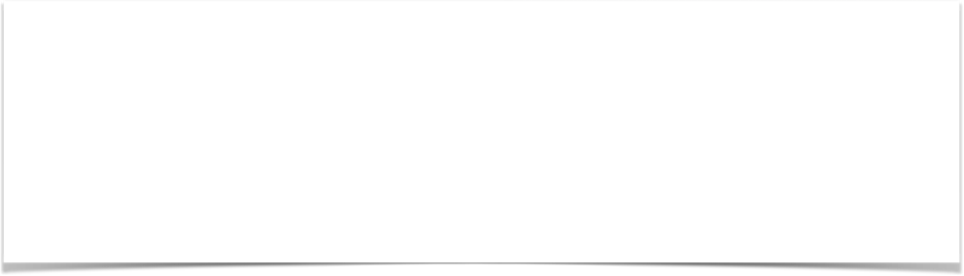
Let’s add some Material Design
//Example 4
@override
Widget build(BuildContext context) {
return MaterialApp(
title: ‘Tech Watch Detroit’,
);
}
}
Notes:
MaterialApp - based on Google’s Material design
This will not run yet
The MaterialApp Constructor is called with Named Parameters

Slide 17
‘Let’s talk about Widgets and Constructors’
Notes:
Why do I like Flutter?
It is very quick to put together an app -> numerous testimonies of coding an app over a weekend
It is intuitive

Slide 18

Widgets and Constructors
Positional and Named Parameters
Flutter -> heavily relies on Named Parameters
Check out the Text Widget
Text(String data, { Key key, TextStyle style, StrutStyle strutStyle, TextAlign textAlign, TextDirection textDirection, Locale locale, bool softWrap, TextOverflow overflow, double textScaleFactor, int maxLines, String semanticsLabel })
Notes:
Everything is an object
Classes have constructors (the first method called when an object of that class is created)
Constructors can have Positional and Named Parameters
Flutter Widgets heavily rely on Named Parameters

Slide 19
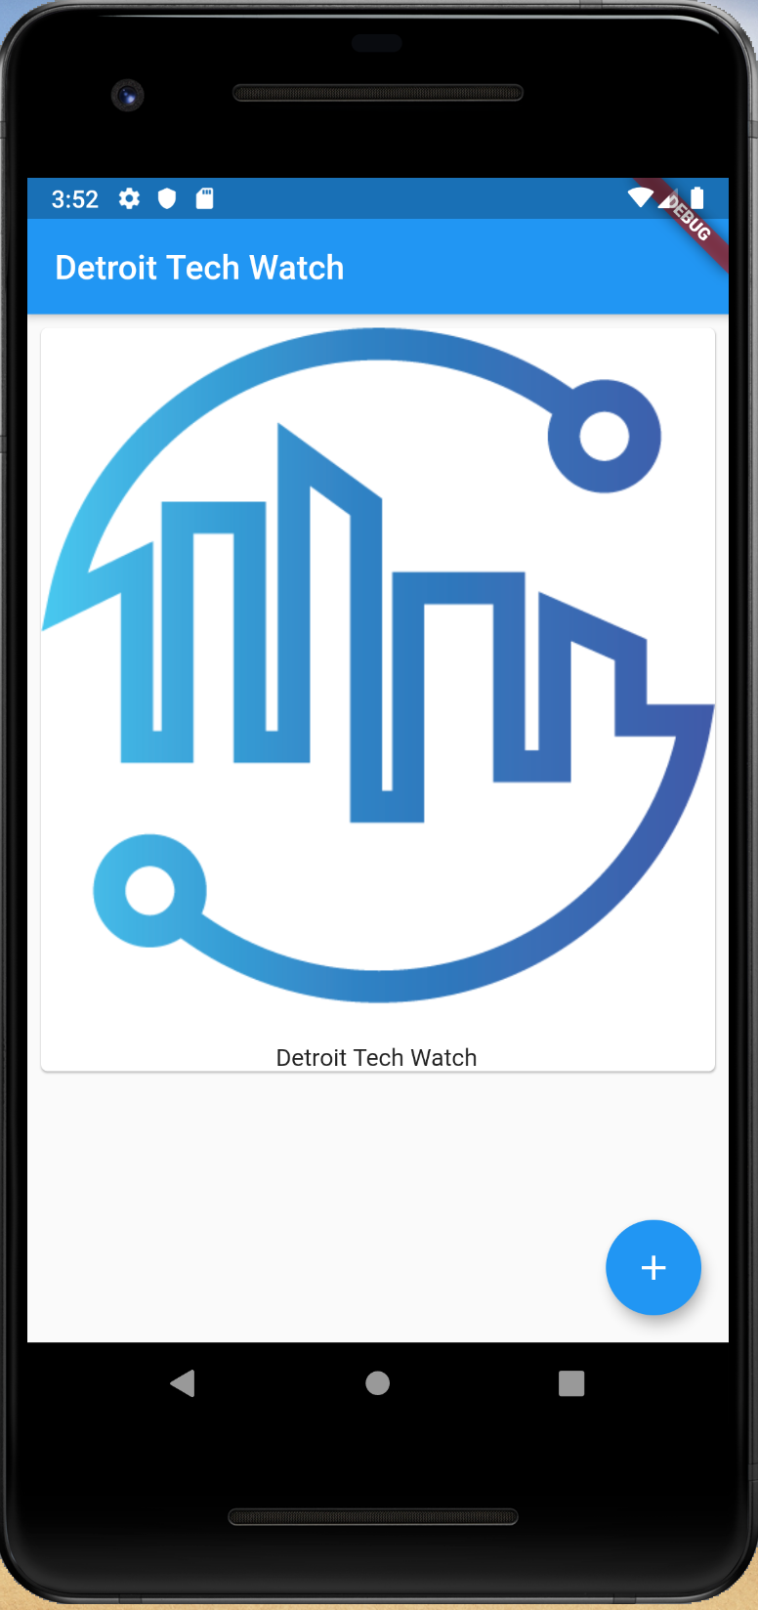
What do we do first?
Add a Card per Image
Add a Floating Action Button

Slide 20
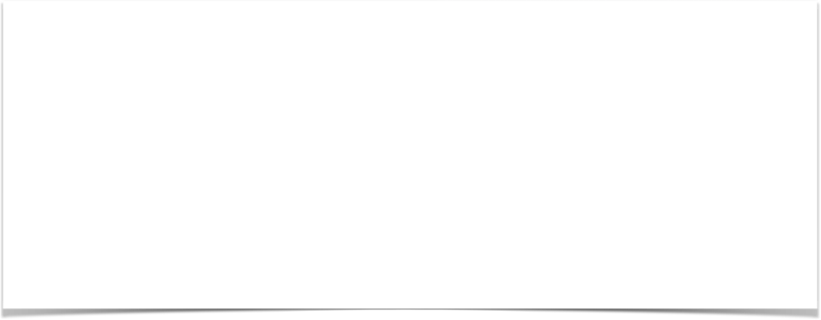
Add a Scaffold for the Screen
//Example 5
return MaterialApp(
title: 'Detroit Tech Watch',
home: Scaffold(
appBar: AppBar(
title: Text('Detroit Tech Watch'),
),
));
Notes:
Run this app - it will display the AppBar with the Text ‘Windsor-Essex DevFest’

Slide 21
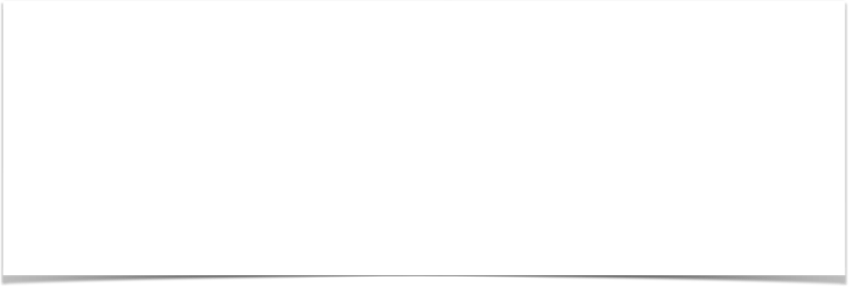
Add a Card to the Body
//Example 6
home: Scaffold(
appBar: AppBar(title:Text('Detroit Tech Watch'),),
body: Card(child: ,));
}
}
Notes:
This will not run
The Card Widget takes one child (it is a name parameter to the Constructor)

Slide 22
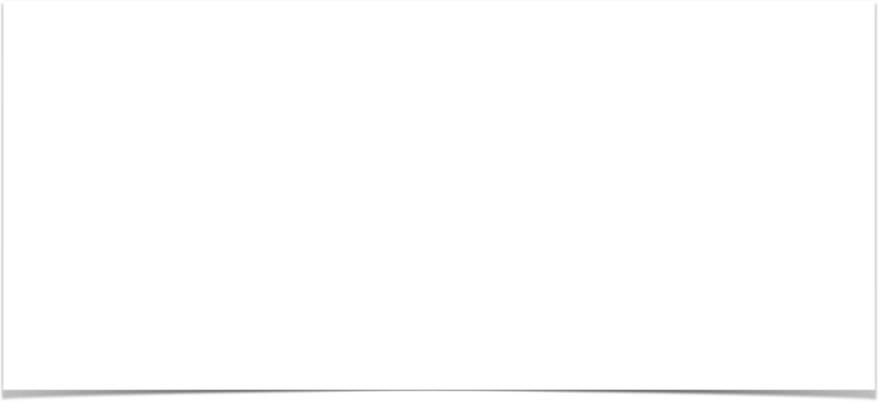
Add a Column to the Card
//Example 7
home: Scaffold(
appBar: AppBar(
title: Text(‘Detroit Tech Watch’),
body: Card(child: Column(children: <Widget>[],),
),
));
}
}
Notes:
This will not run
Add a Column child to the Card - it takes a list of children widgets

Slide 23

Let’s add some images to the project
Steps
Create a new assets folder and add images
Modify pubspec.yaml file
Notes:
Create a new assets folder and add images
Modify pubspec.yaml file and uncomment.
#assets
#- images/a_dot_burr.jpeg
Change images files to,
- assets/GDGWindsor.png
- assets/Google.png
- assets/WindsorDevFest.png
****Make sure tab indents are correct!****

Slide 24
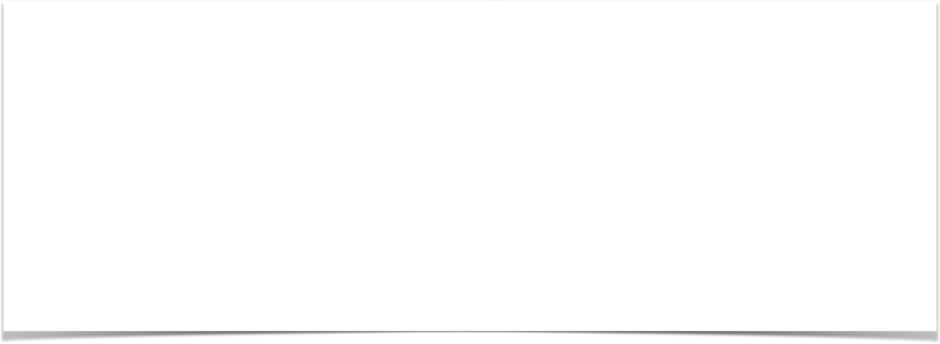
Add a Image to the Card
//Example 8
body: Card(
child: Column(
children: <Widget>[
Image.asset(‘assets/dtw.png'),
],
),
)));
}
}
Notes:
This will not run
Add a Column child to the Card - it takes a list of children widgets

Slide 25

Add some padding under the image
//Example 9
<code above here>
Padding(
padding: const EdgeInsets.all(8),
),
],
),
)));
<code below here>
Notes:
This will run

Slide 26
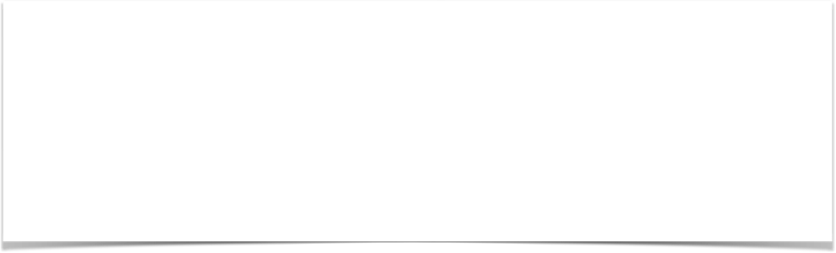
Add some margin around the image in the card
//Example 10
<code above here>
body: Card(
margin:EdgeInsets.all(8),
child: Column(
children: <Widget>[
Image.asset(‘assets/dtw.png'),
<code below here>
Notes:
This will run

Slide 27

Wrap it in a ListView
//Example 11
<code above here>
body: ListView(
children: <Widget>[
Card(
margin: EdgeInsets.all(8),
child: Column(
<code below here>
Notes:
This will run
Listview makes the screen scalable

Slide 28
Wrap it in a Stack
//Example 12
<code above here>
home: Scaffold(
appBar: AppBar(
title: Text('Windsor-Essex DevFest'),
),
body: Stack(
children: <Widget>[
ListView(
children: <Widget>[
<code below here>
Notes:
This will run
Stack gives us absolution positioning of it’s children widgets
This will allow us to get the Floating Action Button

Slide 29

Let’s add a FAB
//Example 13
<Cardview code above here>
),
FloatingActionButton(
child: const Icon(Icons.add),
onPressed: () {},
)
],
)));
<code below here>
Notes:
This will run
This will all us to get the Floating Action Button
Look at the position of it although

Slide 30
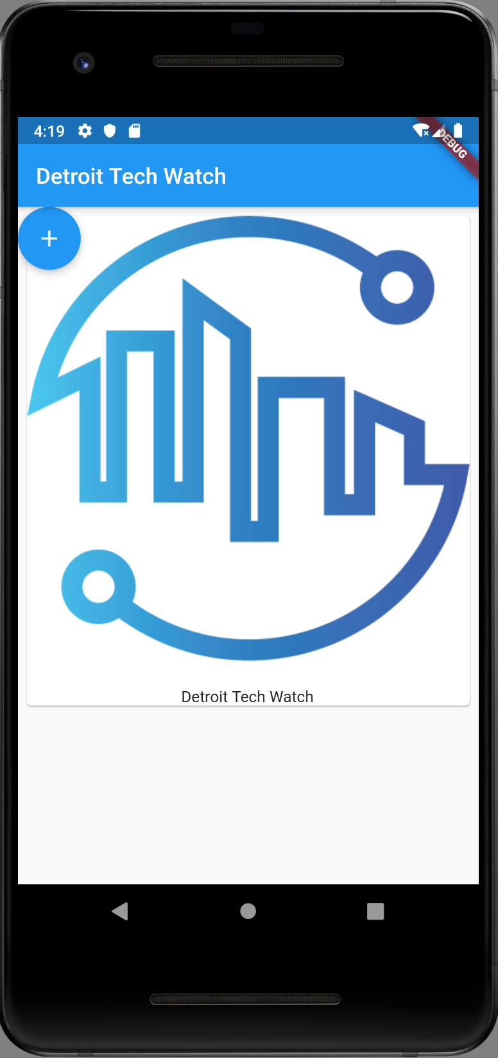
What happened to the Floating Action Button?

Slide 31
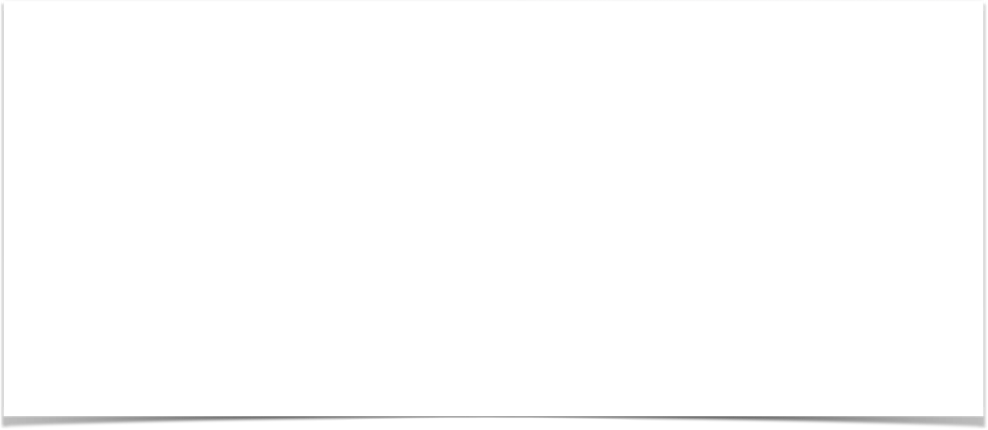
Let’s move the Floating Action Button
//Example 14
<Cardview code above here>
Positioned(
bottom: 16.0,
right: 16.0,
child: FloatingActionButton(
child: const Icon(Icons.add),
onPressed: () {},
))
],
)));
<code below here>
Notes:
This will run
Position of FAB fixed

Slide 32
Everything is in place now - let’s wire up the button and images to the list
WARNING: BOILERPLATE CODE AHEAD

Slide 33
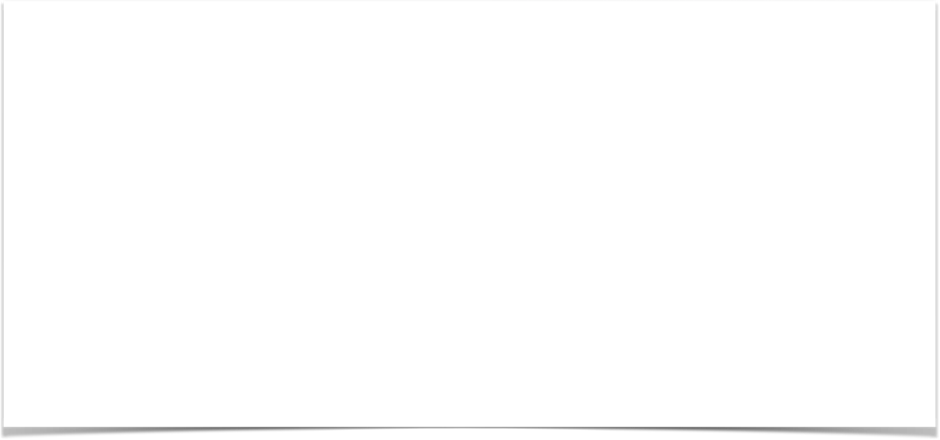
Let’s add some constants for the Images
//Example 15
class MyApp extends StatelessWidget {
// Declare a set list of images to cycle through
final List<Image> _itemImages = [
Image.asset('assets/Google.png'),
Image.asset('assets/dtw.png'),
Image.asset(‘assets/GDGDetroit.png')
];
int _index = 0;
List<Image> _listOfImagesForScreen = [];
Notes:
This will run
Private or Instance variables use the prefix _ as shown with _listOfImagesForScreen

Slide 34
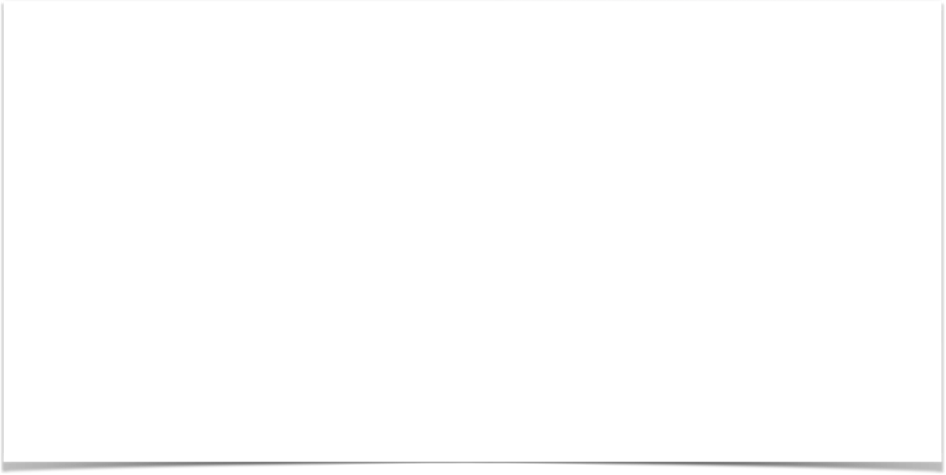
Let’s add a button pressed handler
//Example 16
//Add to the main class above the build method
void onButtonPressed() {
// setState(() {
_index++;
if (_index >= _itemImages.length) {
_index = 0;
}
_listOfImagesForScreen.add(_itemImages[_index]);
print('Item Name = ' + _listOfImagesForScreen.toString());
}
Notes:
*** Added a call in the Button Pressed Handler to call this when pressed
Wired up the Button Pressed Handler - but it only prints the list to the console
Run this to see!

Slide 35
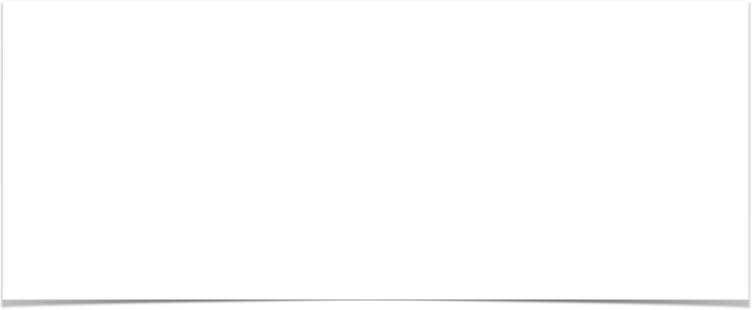
Boiler Plate Code Alert - Making a class Stateful
//Example 17
class MyApp extends StatefulWidget {
@override
State<StatefulWidget> createState() {
return _MyAppState();
}
}
class _MyAppState extends State<MyApp> {
Notes:
Stateful Classes hold state and return an object of type state
***Show where this is in the code
Not ready to run yet!!

Slide 36
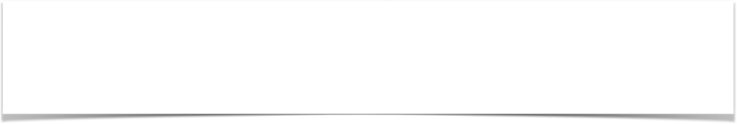
Redraw the Listview with all of the Images every time state changes
//Example 18
ListView(
children: _listOfImagesForScreen.map((element)
Notes:
Iterate over the List of Images every time state changes and redraw the list
This will run

Slide 37
What did we learn?
Command Line Tool for Flutter
Project Structure
Widgets
Constructors and Named Parameters
Stateless and Stateful Widgets
https://github.com/donwardpeng/Flutter-DetTechWatch
Notes:
Iterate over the List of Images every time state changes and redraw the list
This will run

Slide 38
What questions do you have for me?
Don Ward
@donwardpeng
Notes:
Iterate over the List of Images every time state changes and redraw the list
This will run

